Slide 1
HOTEL BOOKING SYSTEM
-Riya Kumari (RA2011003011009)
-Modhurai Mitra (RA2011003011016)
-Shweta Shukla (RA2011003011023)

Slide 2
CONTENTS
Sl. No. | Topics | Page no. | Teacher’s Sign
1. | Introduction | 3
2. | Requirement Analysis and Software Used | 4
3. | Use case diagram | 5
4. | Activity diagram | 6
5. | Class diagram
6. | Sequence diagram
7. | Collaboration diagram
8. | State diagram
9. | Deployment diagram
10. | Component diagram
11. | Object diagram
12. | Packages
13. | Conclusion
14. | Bibliography

Slide 3

Introduction
UML is an acronym that stands for Unified Modeling Language. Simply put, UML is a modern approach to modeling and documenting software. In fact, it’s one of the most popular business process modeling techniques.
Mainly, UML has been used as a general-purpose modeling language in the field of software engineering. However, it has now found its way into the documentation of several business processes or workflows. For example, activity diagrams, a type of UML diagram, can be used as a replacement for flowcharts. They provide both a more standardized way of modeling workflows as well as a wider range of features to improve readability and efficacy.
This project is a graphic depiction of the interactions among the elements of the hotel booking system. It represents the methodology used in system analysis to identify, clarify and organize system requirements of hotel booking system. Hotel Booking System is online booking engine that allows guests to make secure online reservations through hotel website and helps hotels to accept bookings and collect payments online.

Slide 4
Requirement Analysis and software needed
Requirement Analysis: A requirement specifies a capability or condition that must be satisfied. A requirement can define a function that a system must perform, or a performance condition a system must achieve.
Software used: STARUML is a UML tool by MKLAB is used for making the project.

Slide 5
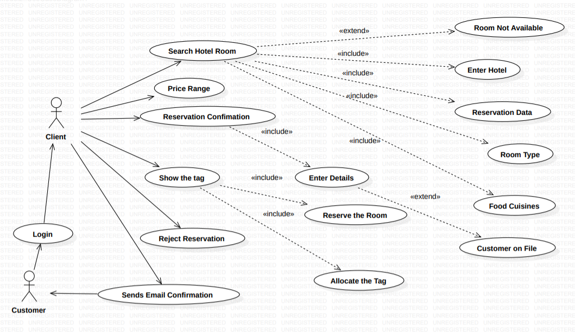
USE CASE DIAGRAM

Slide 6
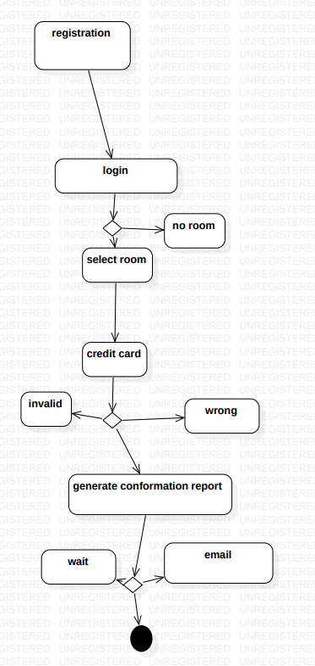
ACTIVITY DIAGRAM

Slide 7
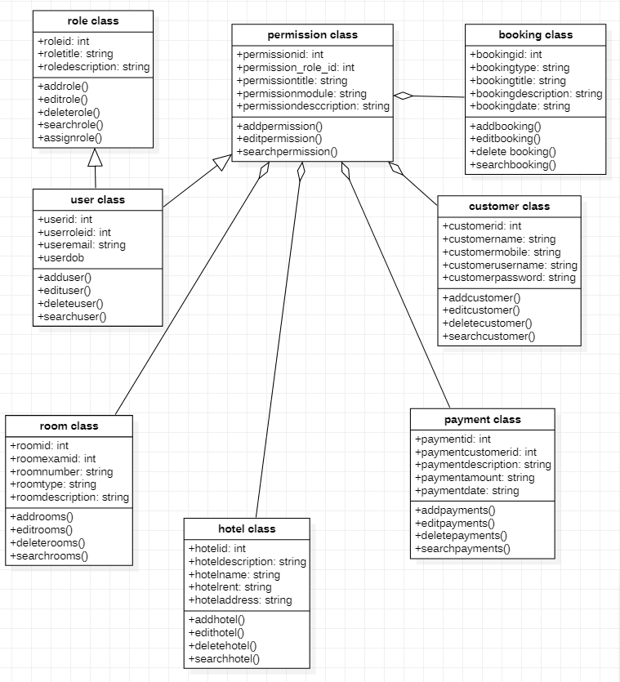
CLASS DIAGRAM

Slide 8
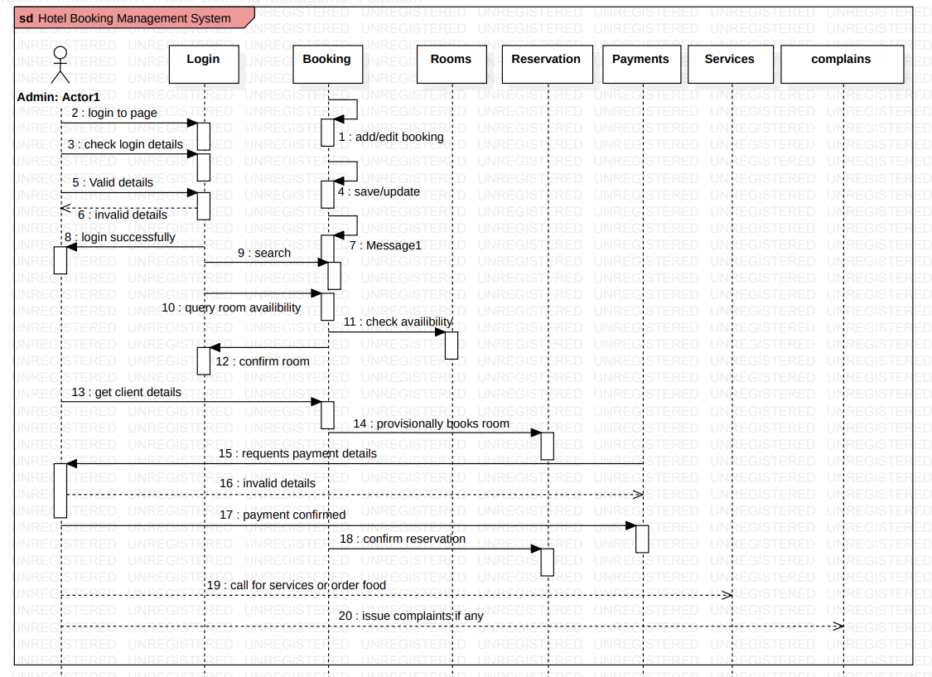
SEQUENCE DIAGRAM

Slide 9
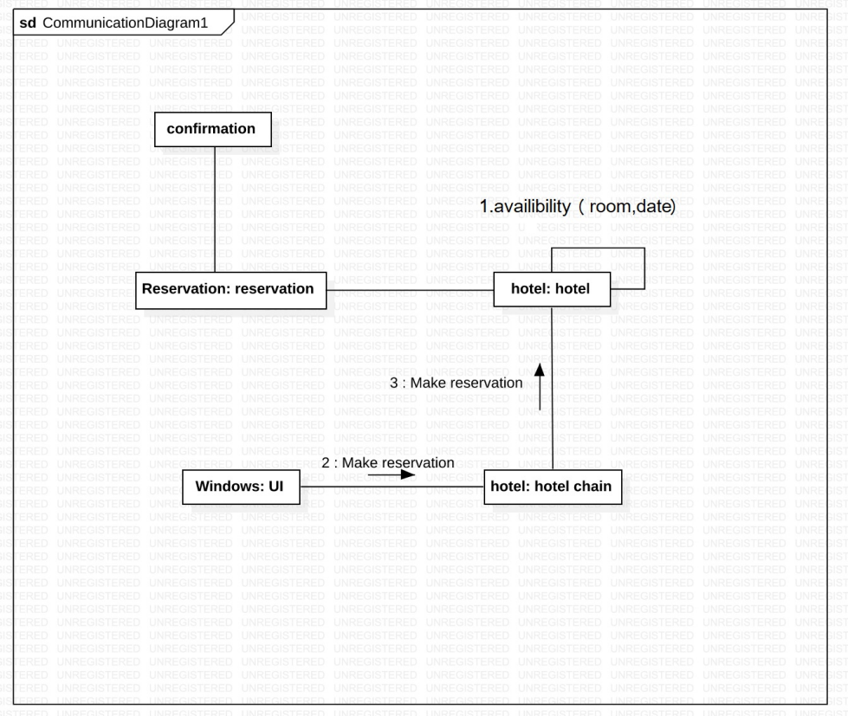
COLLABORATION DIAGRAM
A collaboration diagram is an illustration of the relationships and interactions among software objects in the UML. These diagrams can be used to portray the dynamic behavior of a particular use case and define the role of each object.

Slide 10
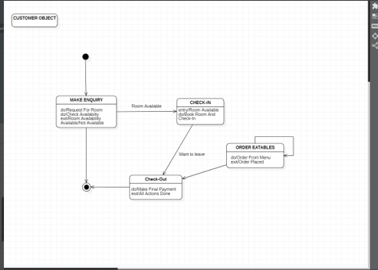
STATE DIAGRAM
A state diagram is used to represent the condition of the system or part of the system at finite instances of time. It's a behavioral diagram and it represents the behavior using finite state transitions

Slide 11
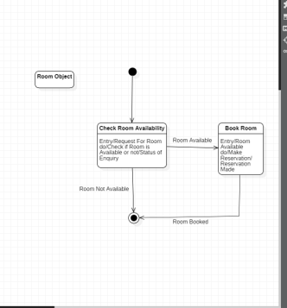
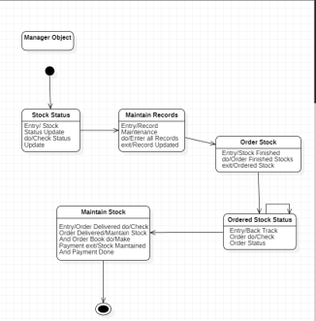

Slide 12
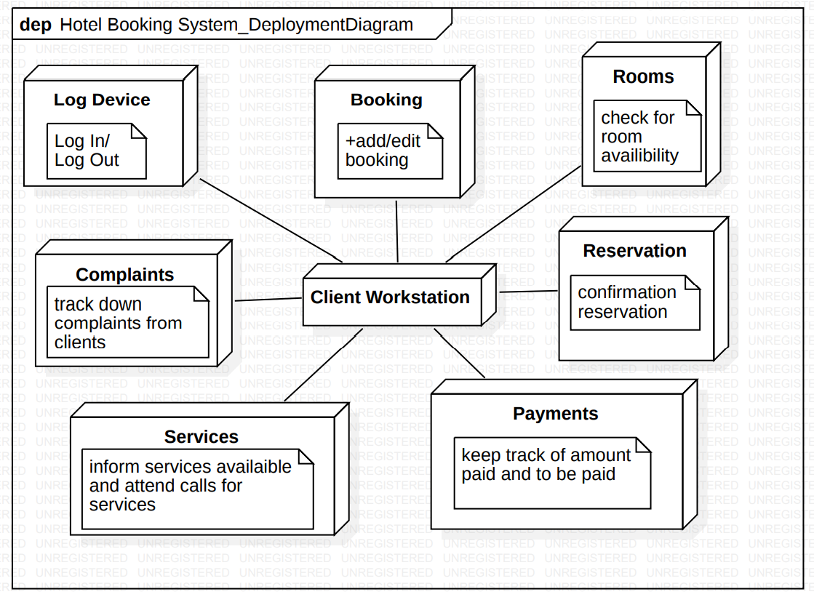
DEPLOYMENT DIAGRAM
A deployment diagram is a UML diagram type that shows the execution architecture of a system. Deployment diagrams are typically used to visualize the physical hardware and software of a system.

Slide 13
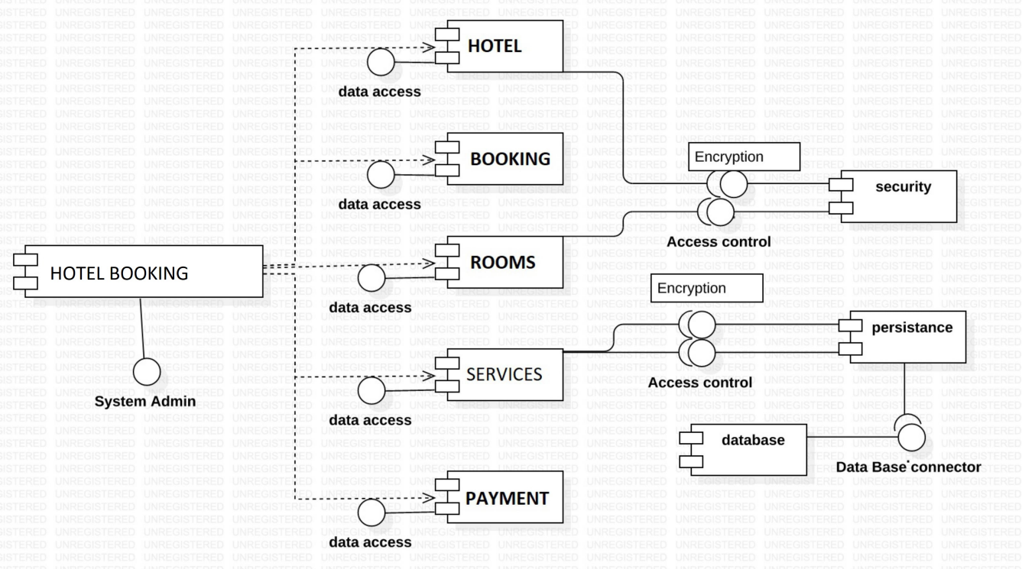
COMPONENT DIAGRAM
Component diagram is a special kind of diagram in UML. It does not describe the functionality of the system but it describes the components used to make those functionalities.

Slide 14
OBJECT DIAGRAM
An object diagram is a graph of instances, including objects and data values. A static object diagram is an instance of a class diagram; it shows a snapshot of the detailed state of a system at a point in time. The use of object diagrams is fairly limited, namely to show examples of data structure.

Slide 15
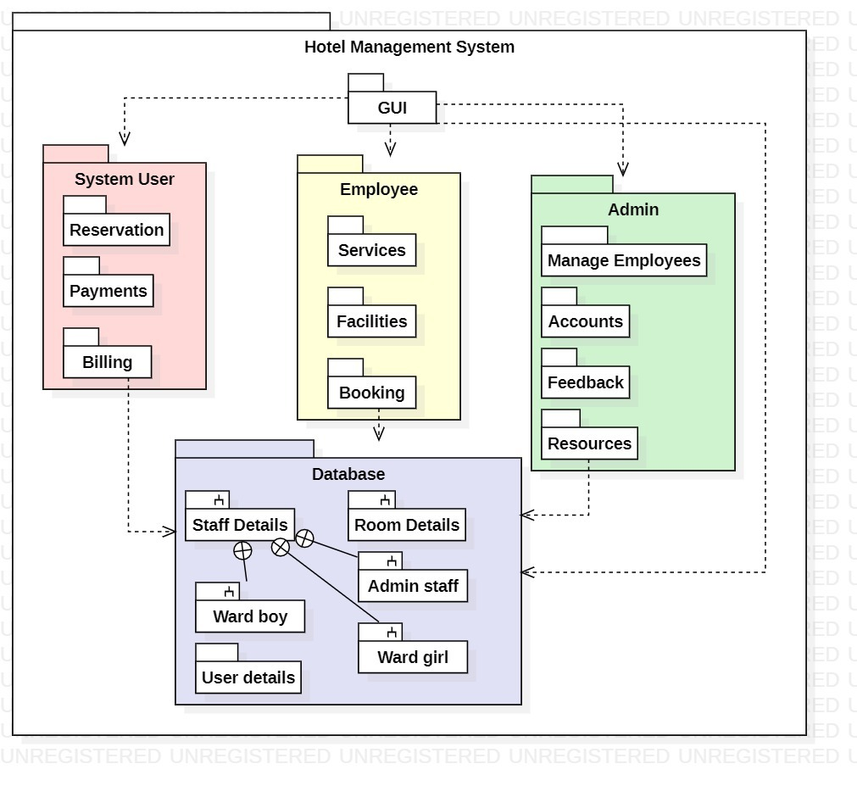
PACKAGES

Slide 16
CONCLUSION

Slide 17
BIBLIOGRAPHY

Slide 18
THANK YOU.

